Slide 1

4th Year Project
14/12/2022
C00249160-KingaPestka

Slide 2

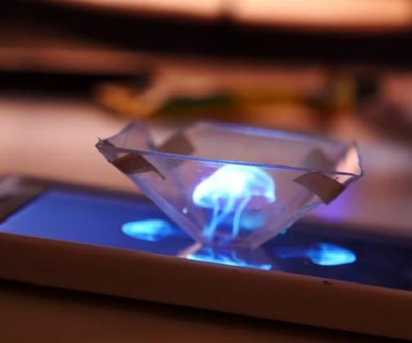
Idea 1
What, Why, How –hologram ,resin, light projection
This Photo by Unknown author is licensed under CC BY-SA.

Slide 3
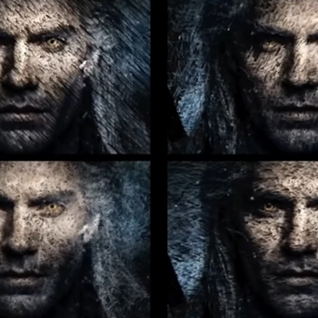
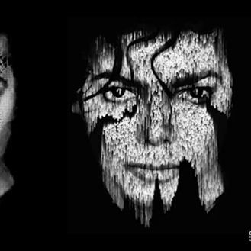
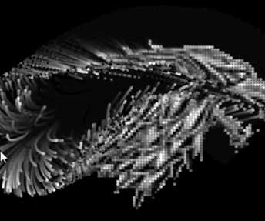
Idea 2
What, Why, How - Rain / modifying images + Shaders, using Webgl and Three.js

Slide 4
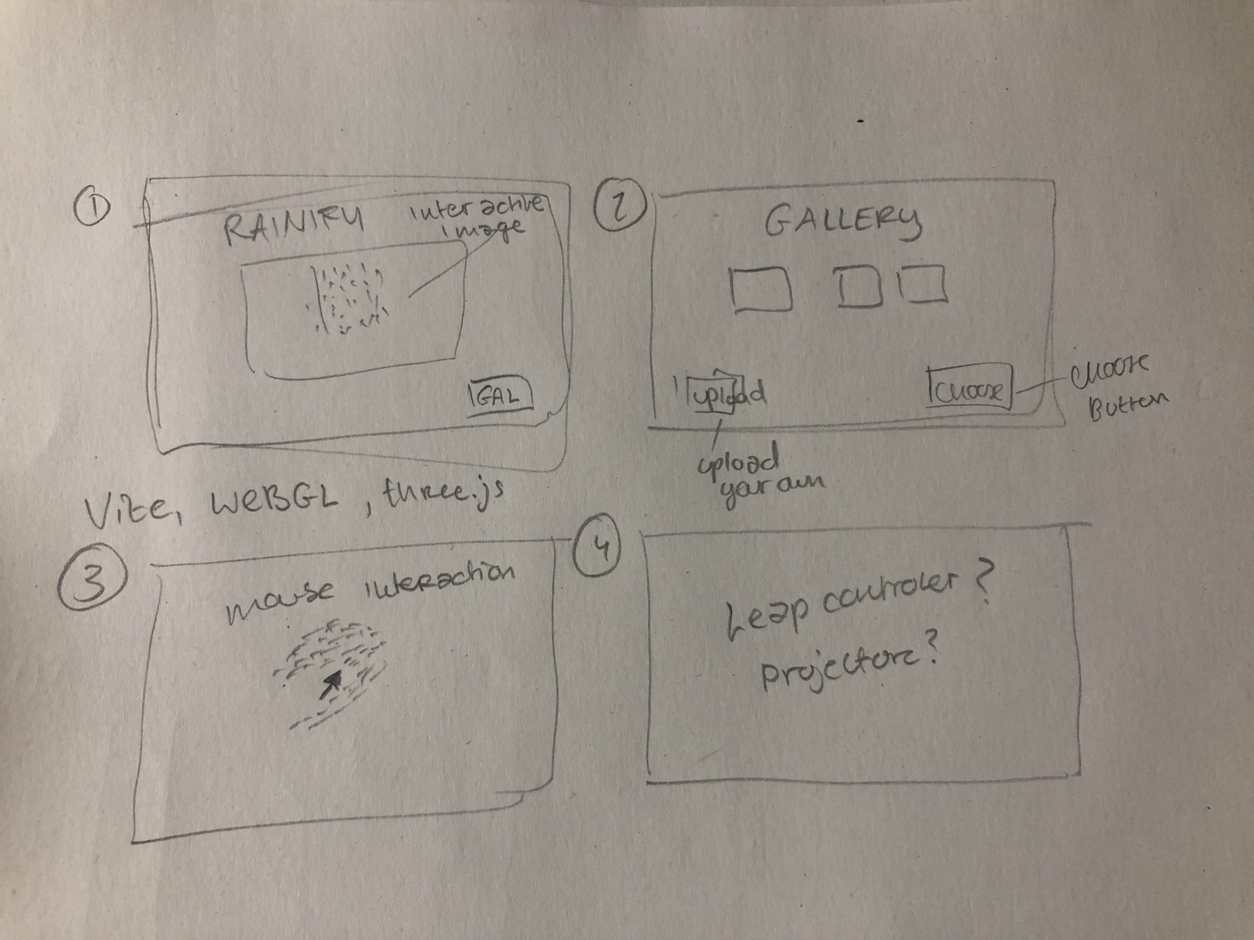
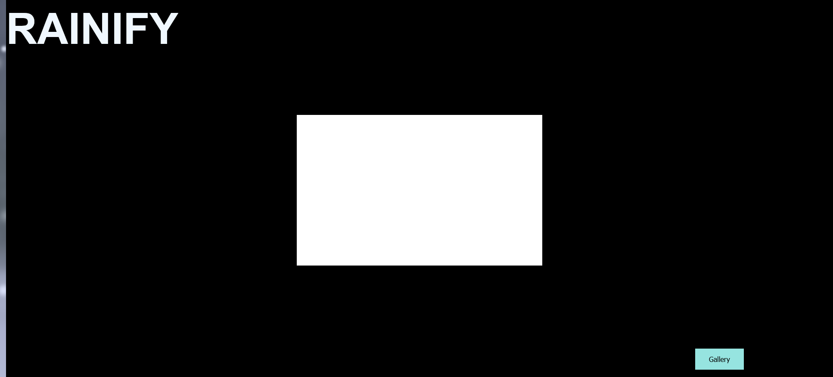
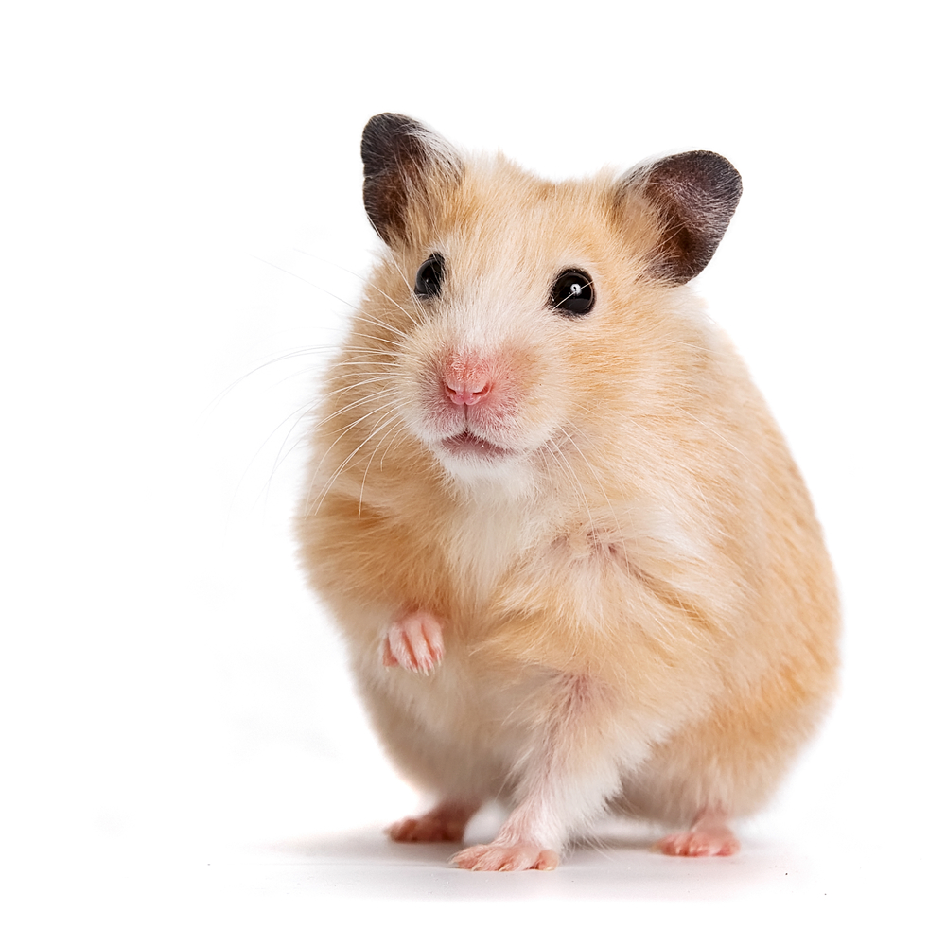
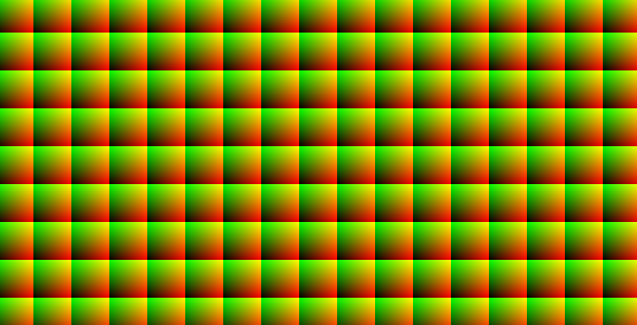
Breaking Builds

Slide 5
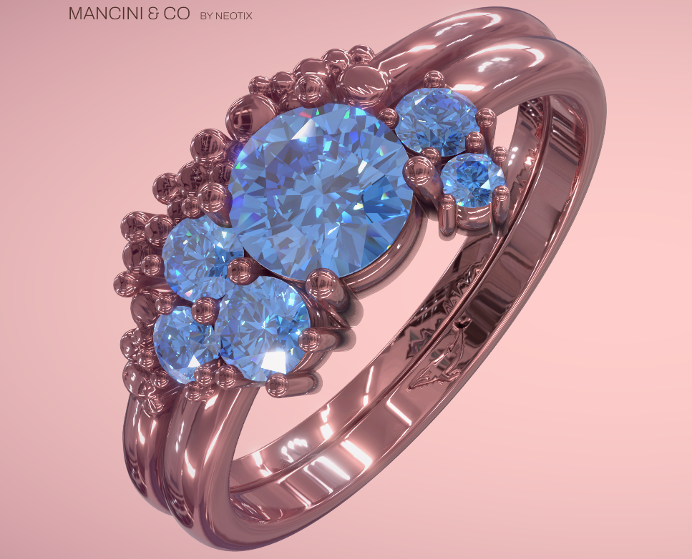
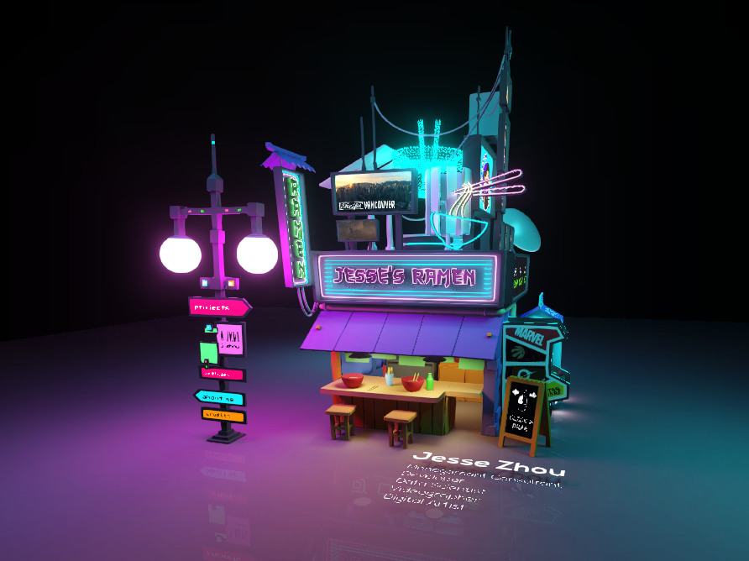
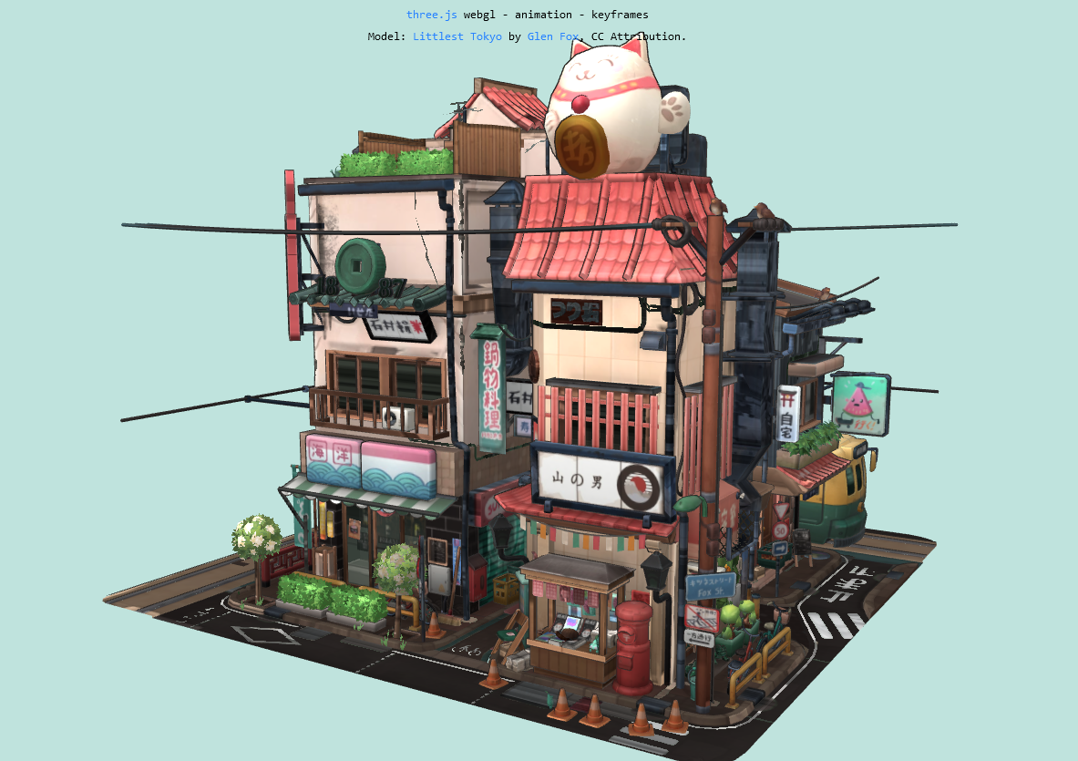
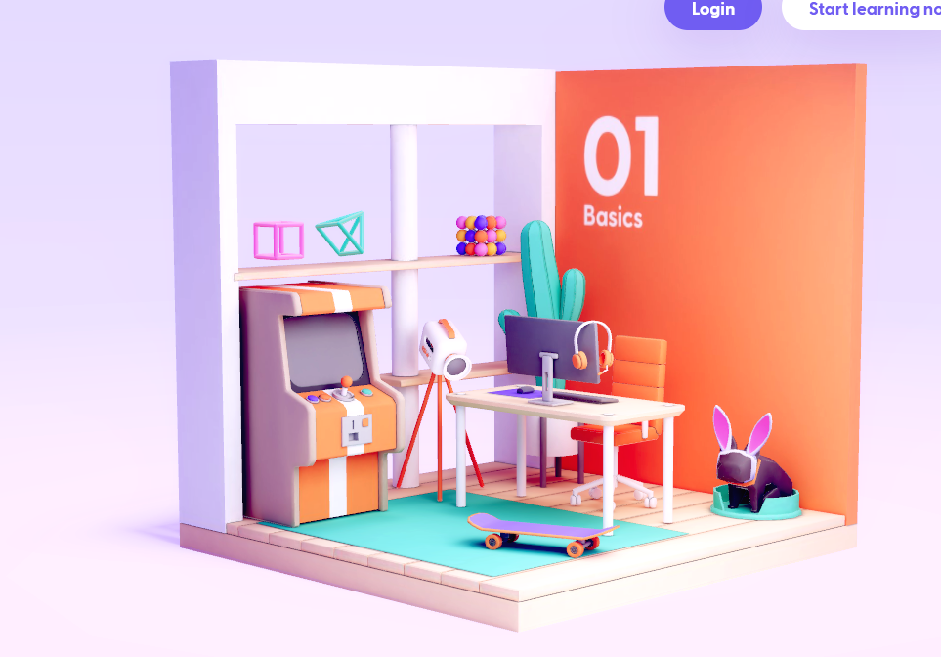
Idea 3
What , Why, How – 3d model placed on platform or plane, preferably a building or object,
Interactive(moveable and zoomable)
Using webgl, three.js and blender+maya

Slide 6
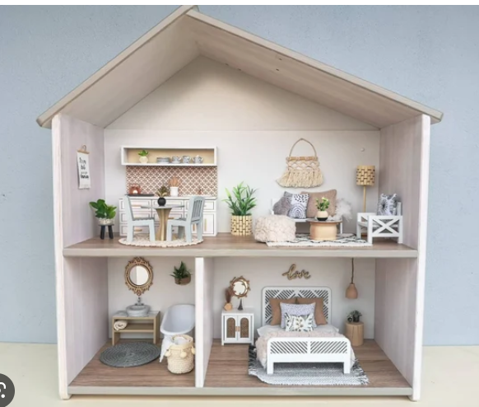
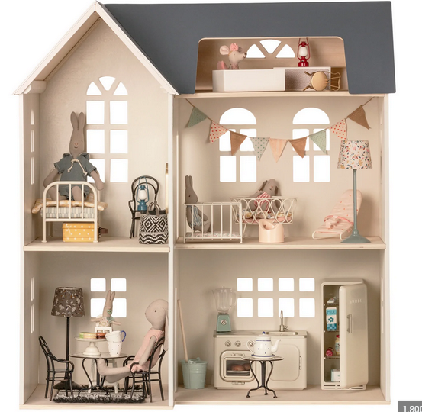
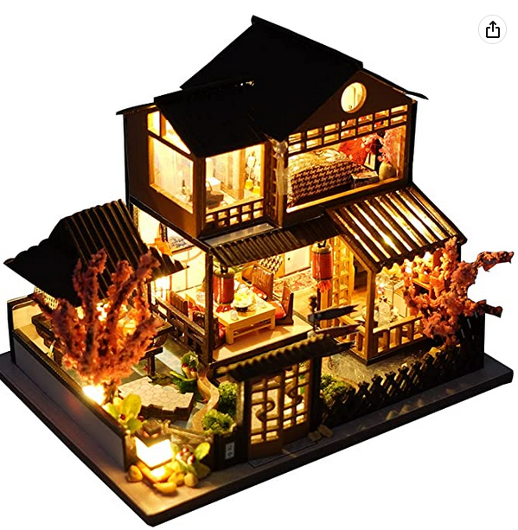
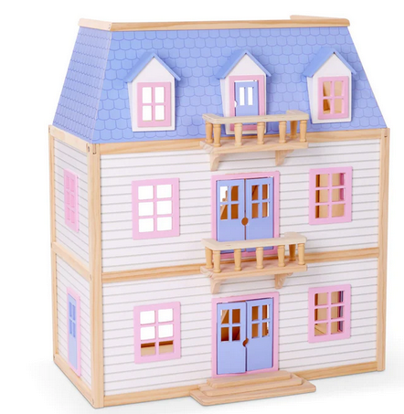
Dollhouse/scene in 3d
3d interactive model
Animated?

Slide 7
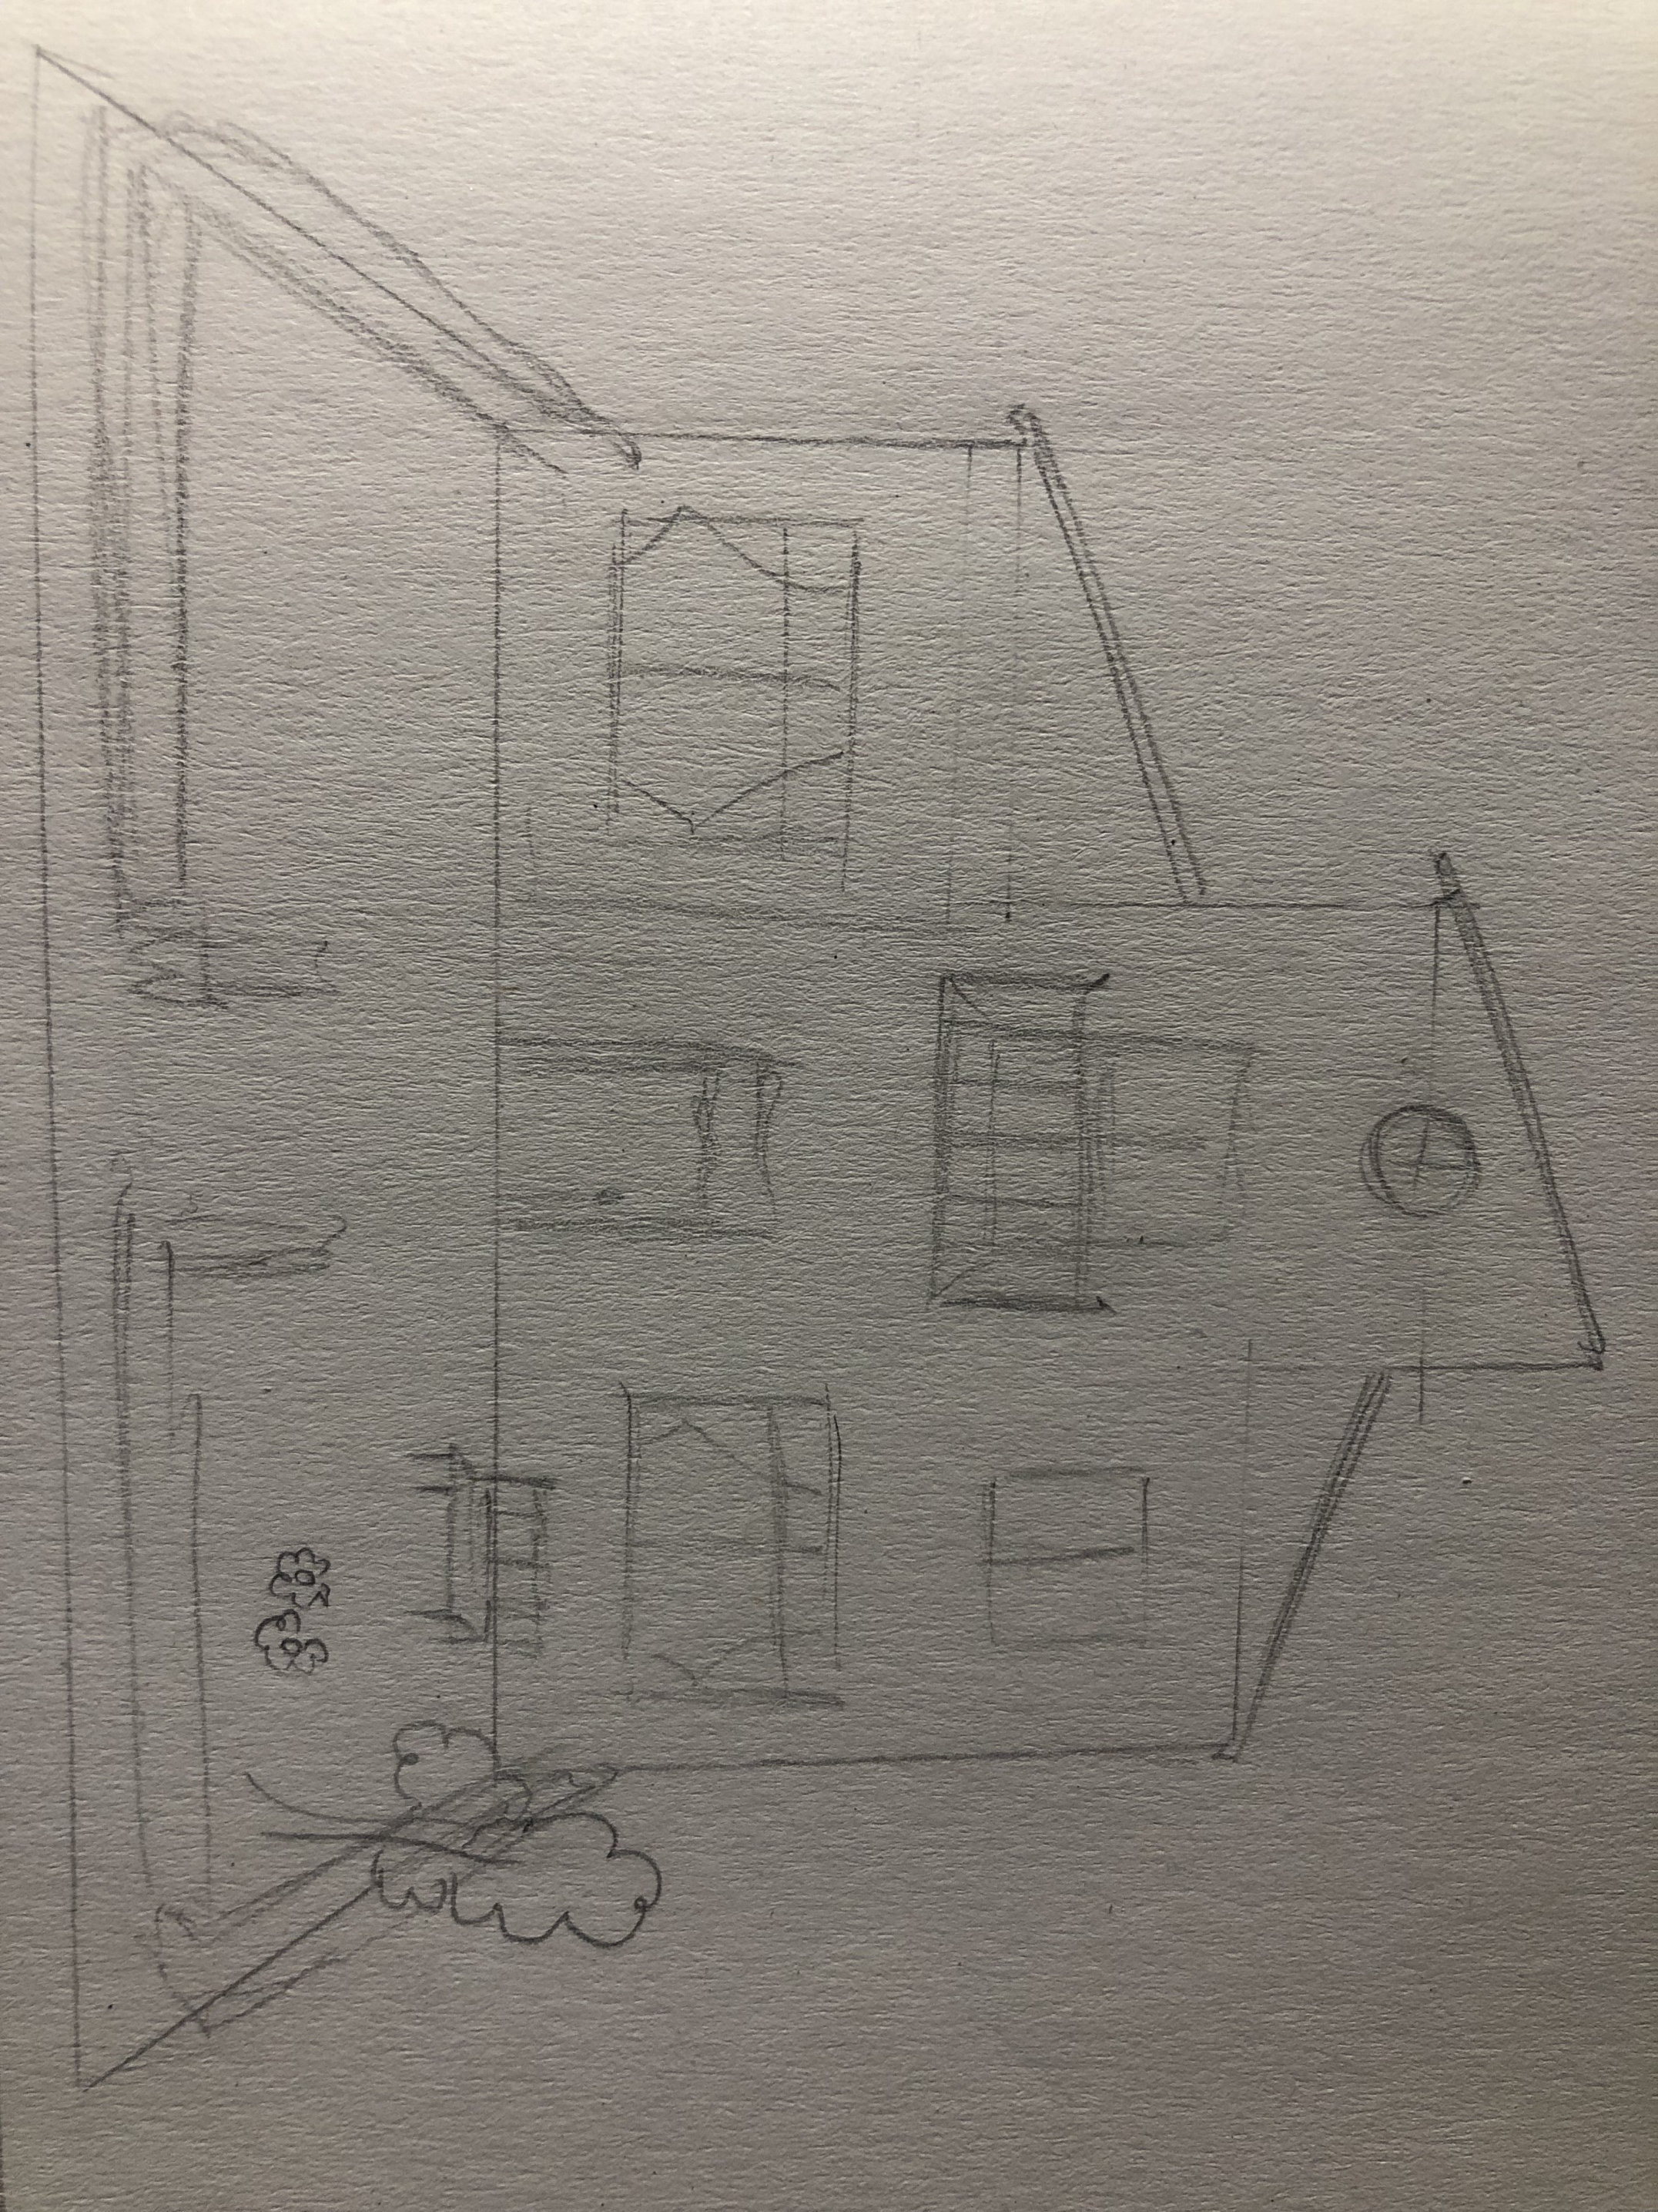
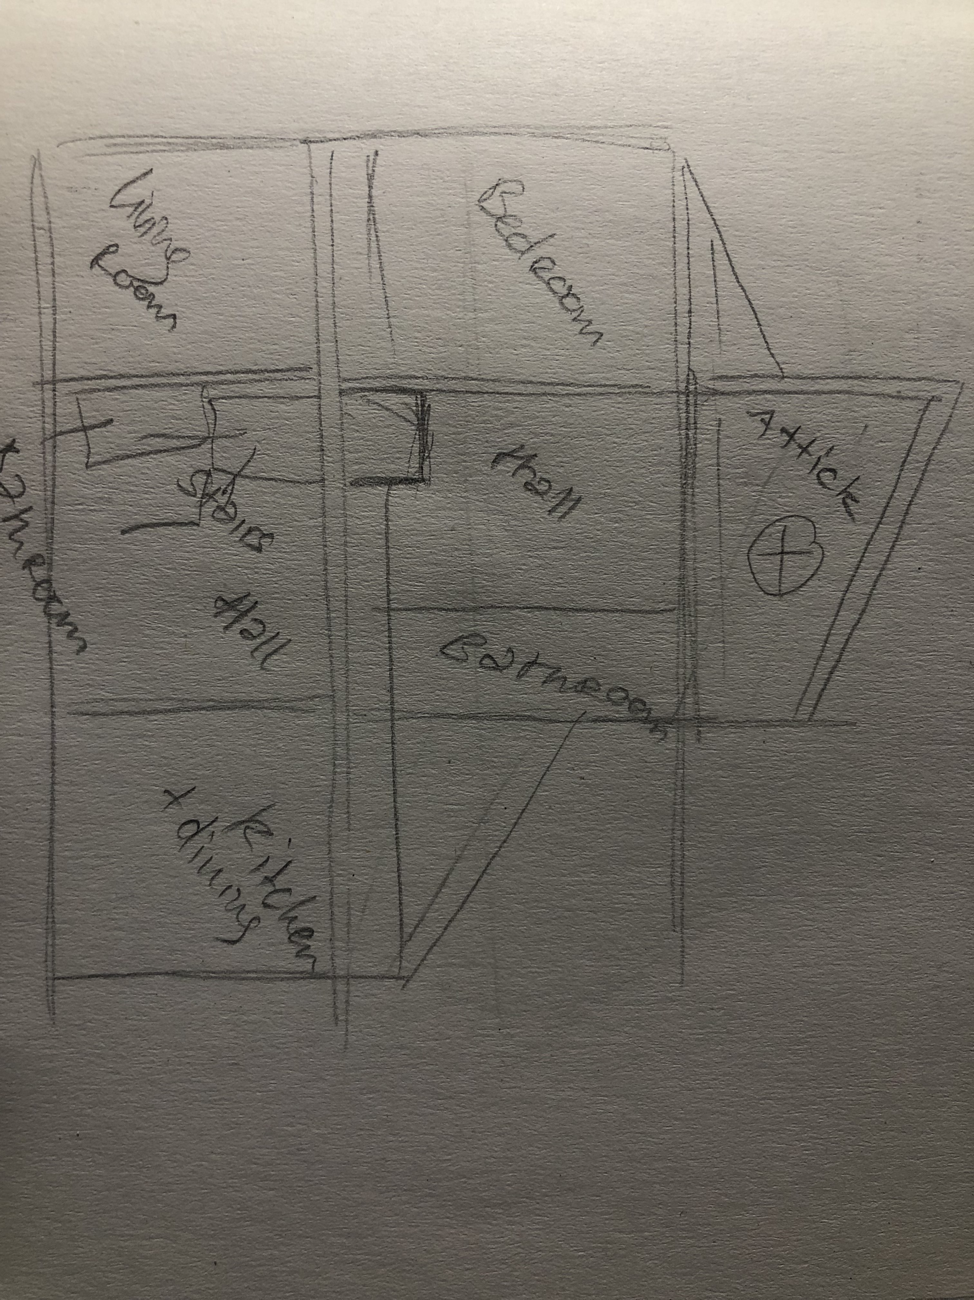
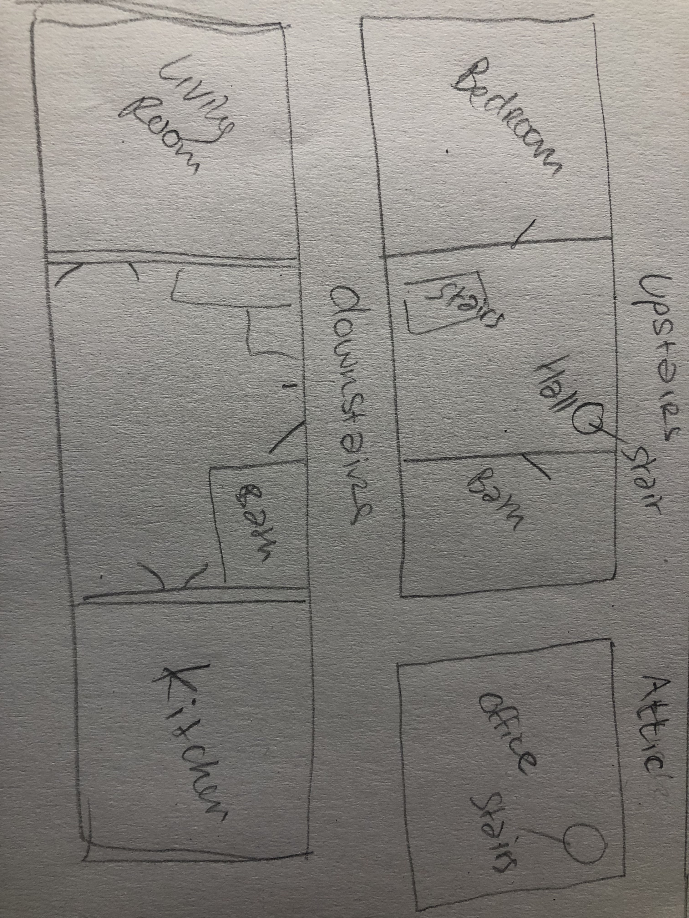
Idea of layout

Slide 8
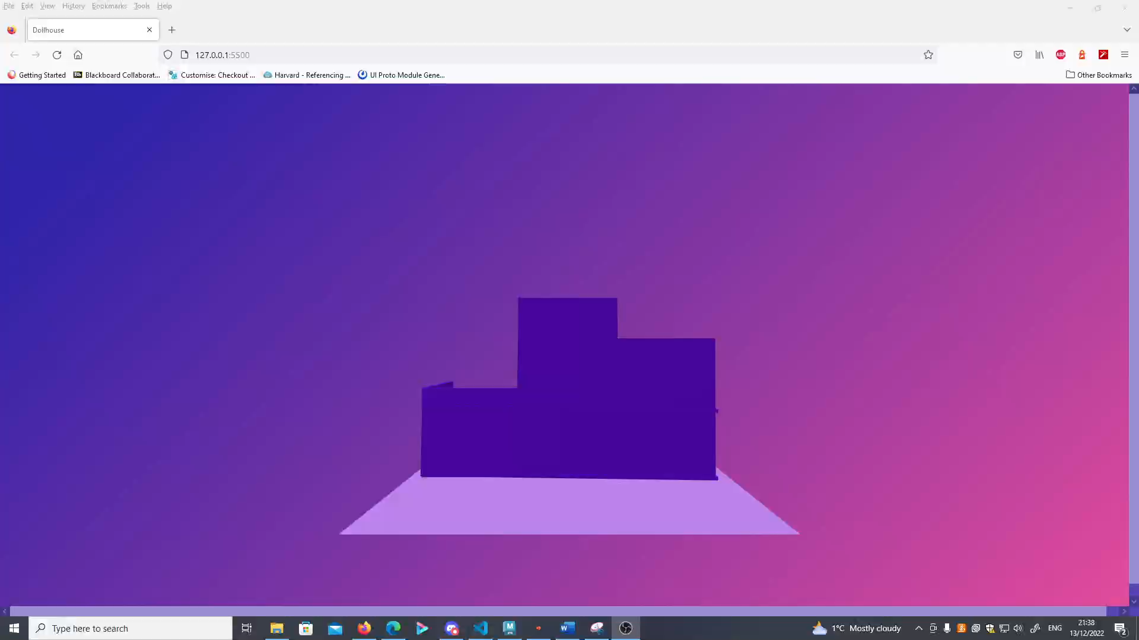
What I am working on

Slide 9
What is left to do
Actual Model in Maya/Blender/Both
Responsive
Work on code related errors + find solutions for problems like loading multiple models at once
Edit interaction to perhaps zoom into specific areas rather than an assigned particular point on map/plane
Figure out issues related to textures
File formatting issues (relates to textures too)
A lot left to do ☺

